Slide 1



SQL
PROJECT ON PIZZA OUTLET SALES
BY RAJ SHEKHAR SINGH

Slide 2

PROJECT DETAILS
During this project, I analyzed the sales data of a pizza outlet that sells various product categories. I imported all the data from a CSV file into MySQL. Created different Schemas Subsequently, I executed several SQL queries such as JOIN, RANK, SUM, ORDER BY, and OVER to extract essential information needed to comprehend the business and address different inquiries.

Slide 3

QUERIES
Retrieve the total number of orders placed.
Calculate the total revenue generated from pizza sales.
Identify the highest-priced pizza.
Identify the most common pizza size ordered.
List the top 5 most ordered pizza types along with their quantities.
Join the necessary tables to find the total quantity of each pizza category ordered.
Determine the distribution of orders by hour of the day.
Join relevant tables to find the category-wise distribution of pizzas.
Group the orders by date and calculate the average number of pizzas ordered per day.
Determine the top 3 most ordered pizza types based on revenue.
Calculate the percentage contribution of each pizza type to total revenue.
Analyze the cumulative revenue generated over time.
Determine the top 3 most ordered pizza types based on revenue for each pizza category

Slide 4
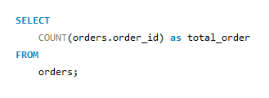
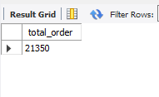
1. RETRIEVE THE TOTAL NUMBER OF ORDERS PLACED.
Query
RESULT

Slide 5
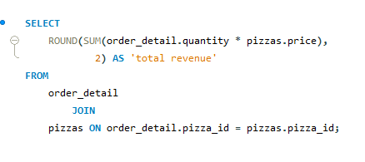
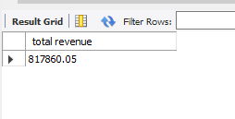
2. CALCULATE THE TOTAL REVENUE GENERATED FROM PIZZA SALES.
QUERY
RESULT

Slide 6
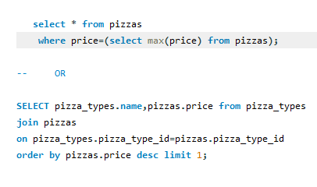
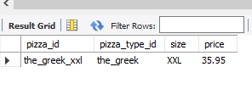
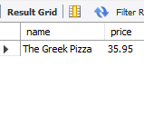
3 . Identify the highest-priced pizza.
QUERY
RESULT
PROJECT TIMELINE

Slide 7
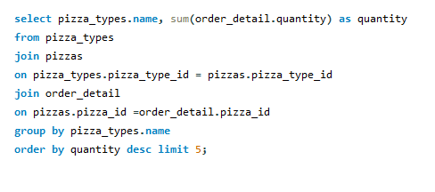
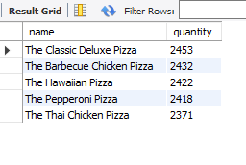
4. List the top 5 most ordered pizza types along with their quantities
QUERY
RESULT

Slide 8
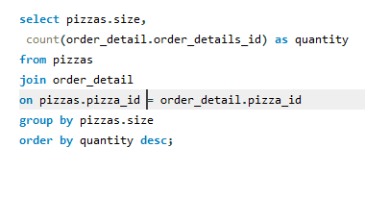
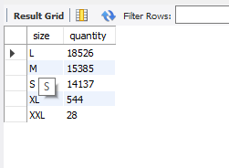
5. Identify the most common pizza size ordered.
QUERY
RESULT

Slide 9
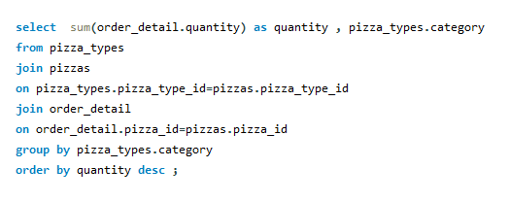
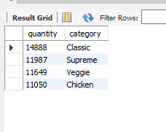
6. Join the necessary tables to find the total quantity of each pizza category ordered.
QUERY
RESULT

Slide 10
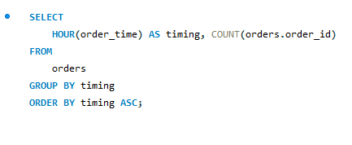
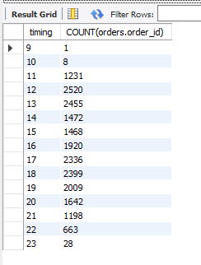
7.Determine the distribution of orders by hour of the day.
QUERY
RESULT

Slide 11

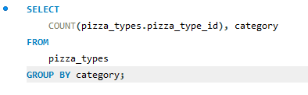
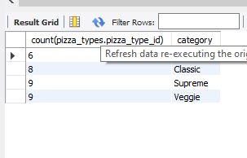
8. Join relevant tables to find the category-wise distribution of pizzas.
RESULT

Slide 12
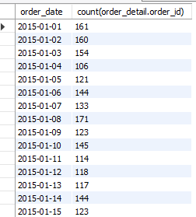
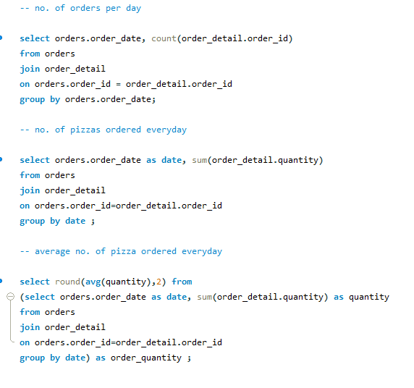
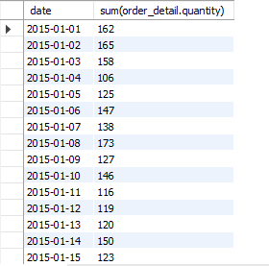

9. Group the orders by date and calculate the average number of pizzas ordered per day.
RESULT

Slide 13
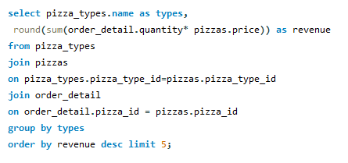
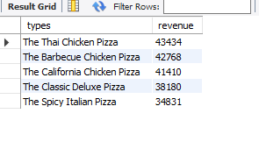
10. Determine the top 5 most ordered pizza types based on revenue.
QUERY
RESULT

Slide 14
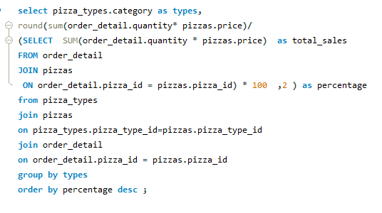
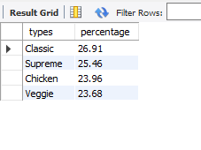
11. Calculate the percentage contribution of each pizza type to total revenue.
QUERY
RESULT

Slide 15
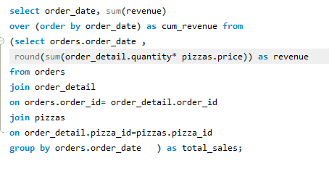
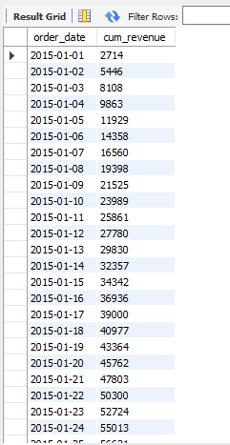
12. Analyze the cumulative revenue generated over time
QUERY
RESULT

Slide 16
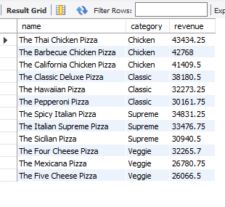
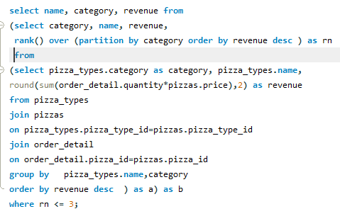
13. Determine the top 3 most ordered pizza types based on revenue for each pizza category.
RESULT
QUERY

Slide 17


